Slide 1
Final Project Calculator
Alex Smith, Guntram Weissenberger, Brandon Rubio, Richard Chin
ECE 315 Digital Design
Zeinab Ramezani, TA
University of Miami
4/18/22

Slide 2
Overview
Design a calculator which can perform addition, subtraction, and multiplication with both positive and negative numbers
Ability to input values between -15 to 15 (4bits) and display results up to 225
Ability to display input and output in decimal on 7 segment display

Slide 3
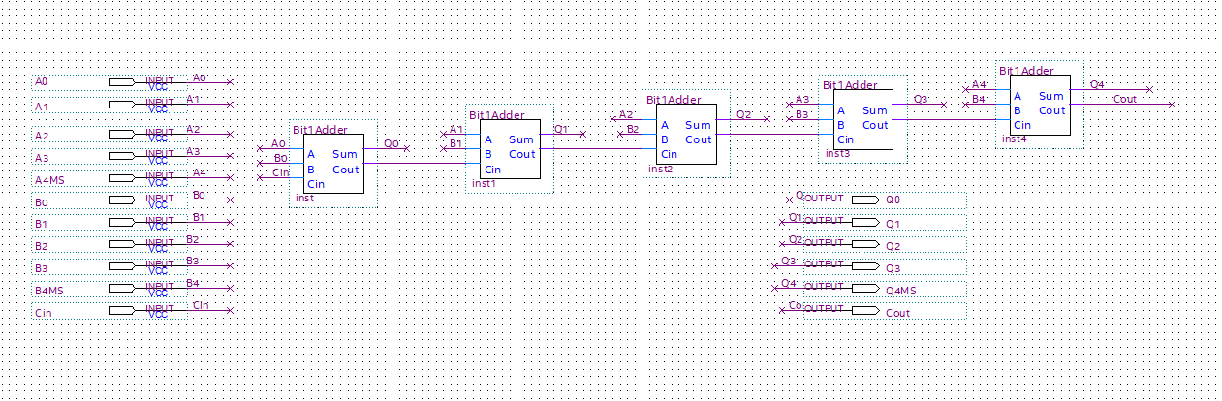
5-bit Adder

Slide 4
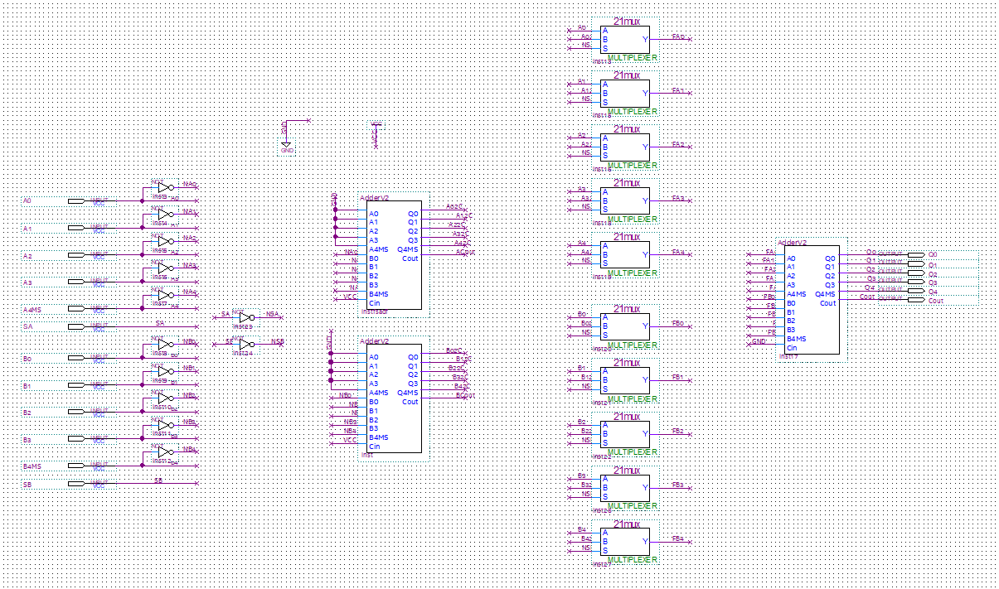
5-bit Adder/Subtracter

Slide 5
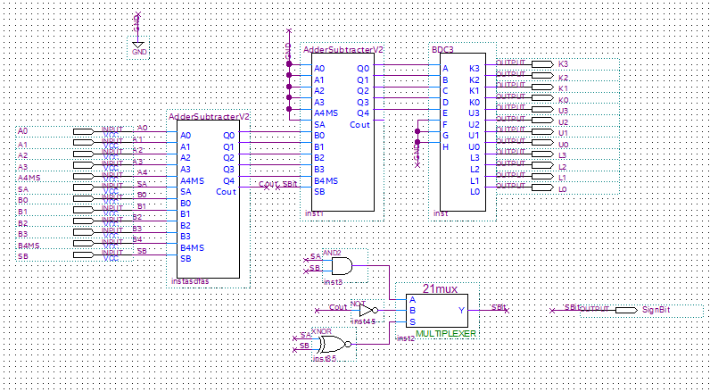
Final 5-bit Adder/Subtracter

Slide 6
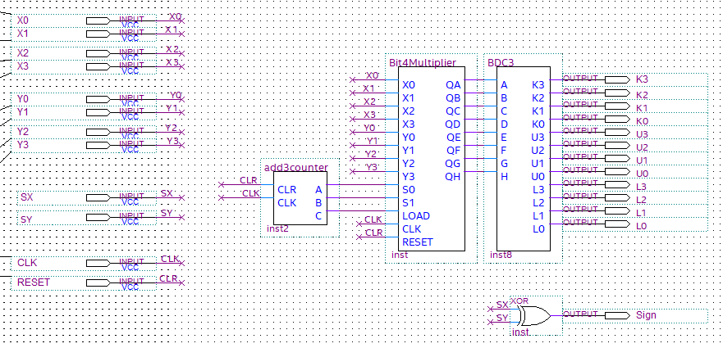
Final 4-bit Multiplier

Slide 7
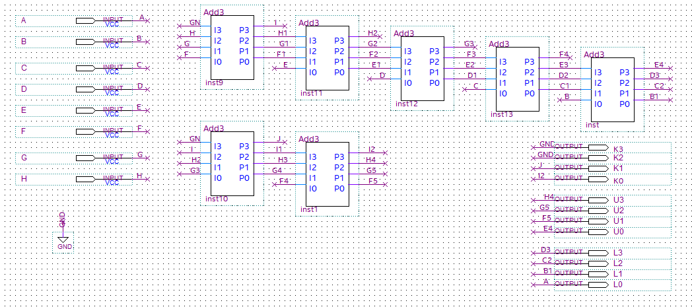
BCD for 0-225

Slide 8
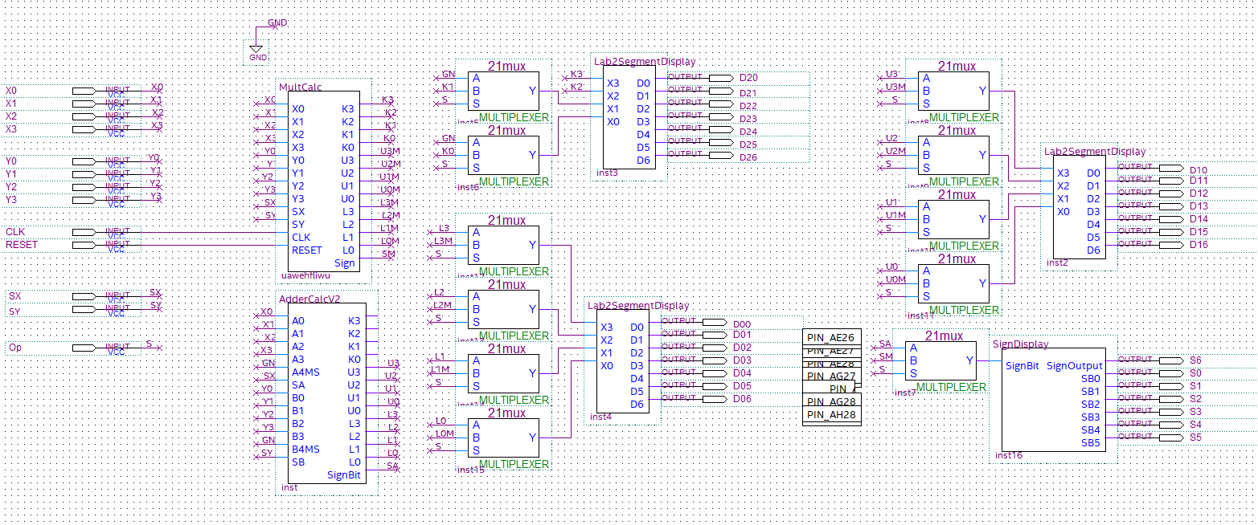
Final Calculator to Seven Segment Display

